Slide 1
Ditch the focus group.
Lean techniques
to make things people really want.
think. plan. thrive.

Slide 2
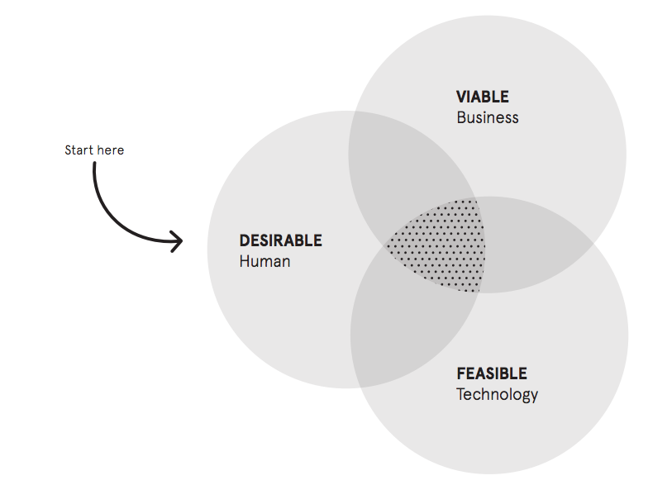

Slide 3
Don’t trust demographics.
(At best, you’ll only get the expensive mainstream).

Slide 4
Find your Otaku.
(Build trust. Collaborate. They’re small but loud…).

Slide 5
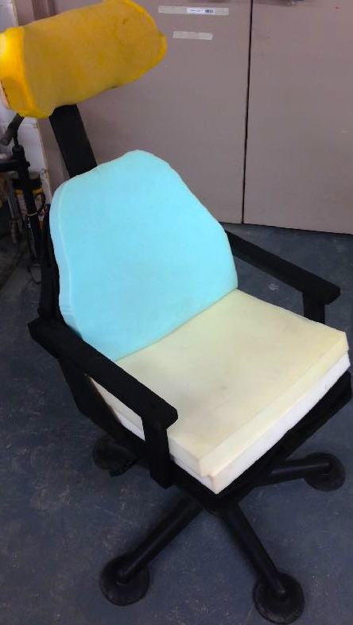

Slide 7
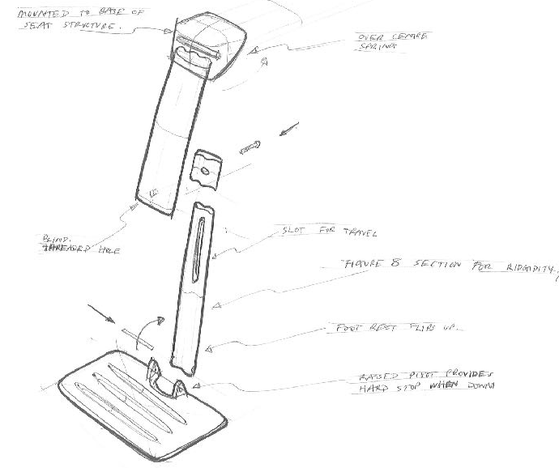

Slide 8
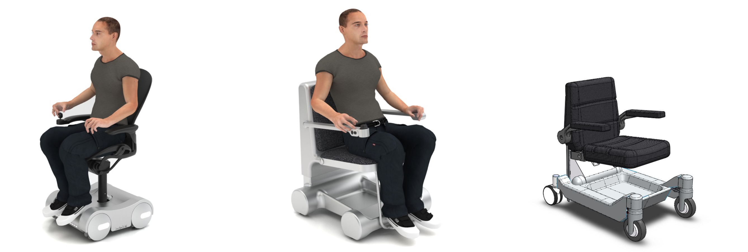
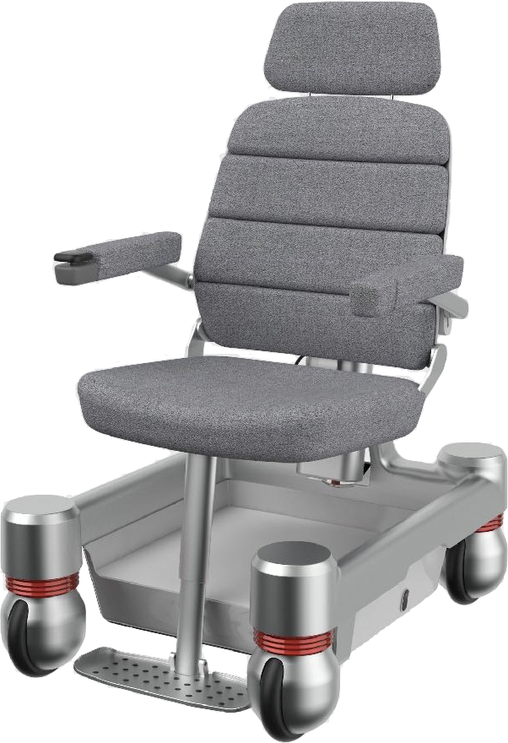

Slide 9
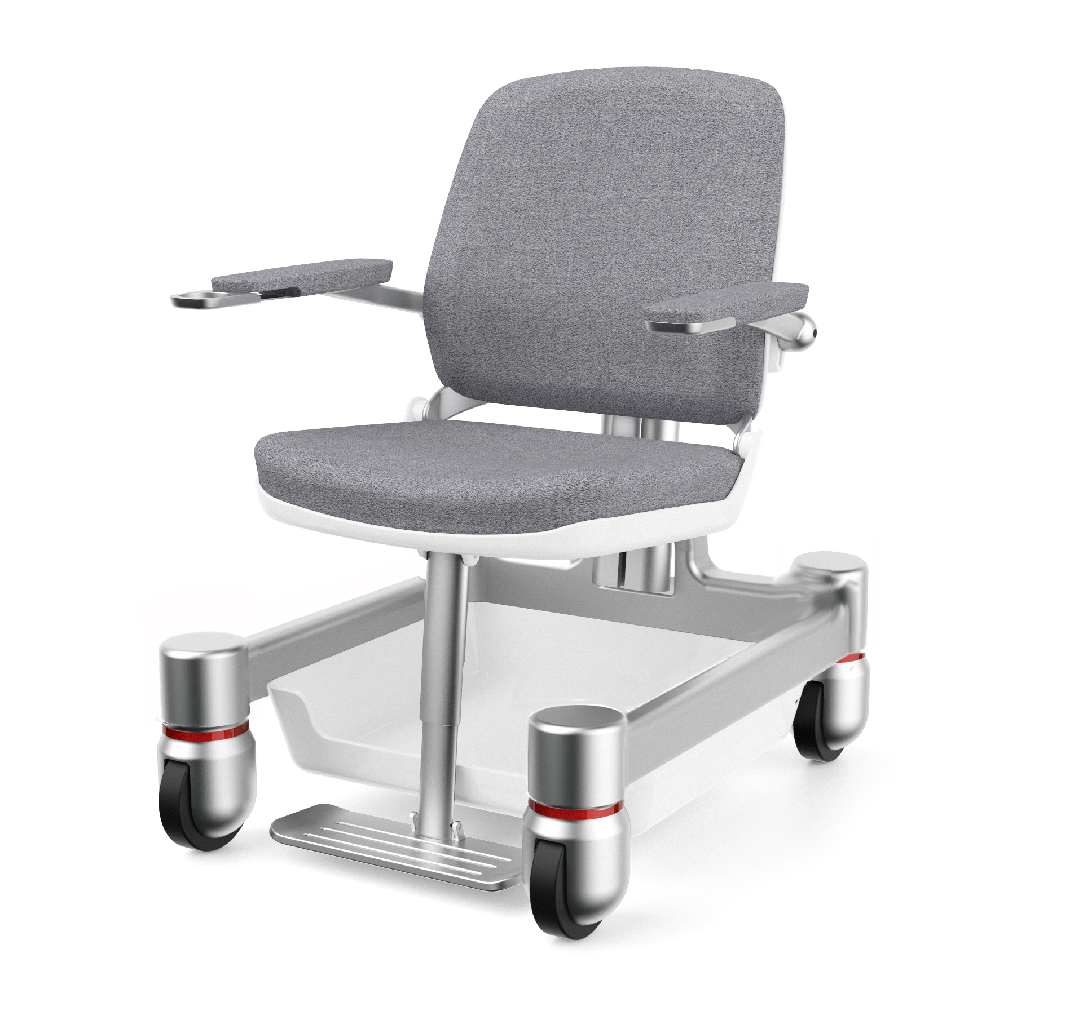
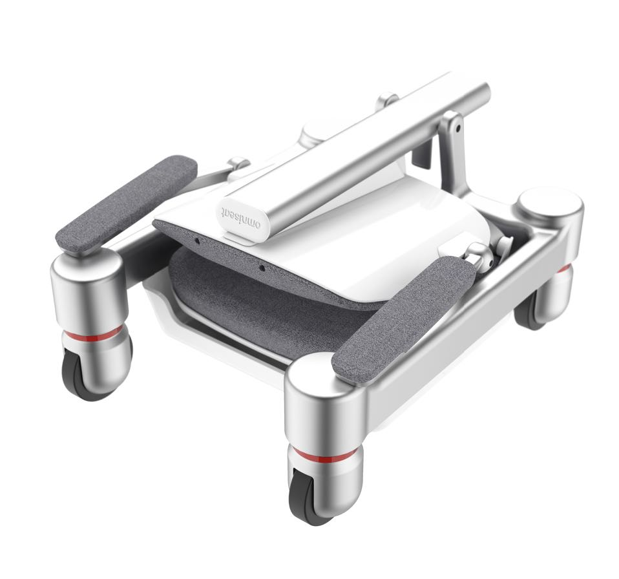

Slide 10
Market Size
Who love cooking…
Disabled People
Independence
Logistics

Slide 11
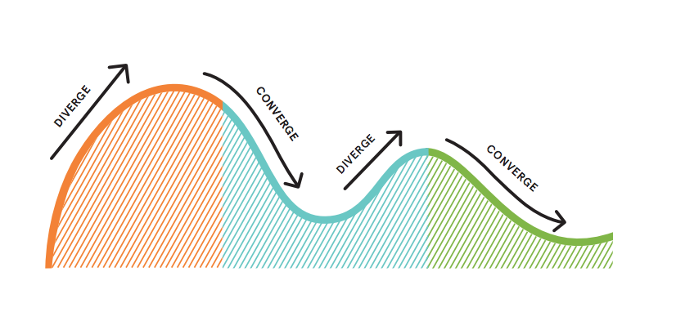

Slide 12
Focus on people, not correlations.
Empathy is the key.
Seek out extreme users.
Embrace ambiguity.
…and prototype everything.
Notes:
Empathy is the key.
New solutions need new perspectives.
Seek out extreme users.
xx
Embrace ambiguity.
You shouldn’t know all the answers, you know.
Prototype everything.
From JTBD to problems, features, needs and wants.

Slide 13
Tools we use.
Seek quick inspiration & feedback.
Existing research…
Prototype. Get feedback.
Collect deep insights.
Notes:
Explore the market. Seek quick inspiration.
Collect deep insights. Into people’s lives. Their everyday contexts, at home, at work, and on the go.
Prototype. Get feedback. On concepts, insights, or value propositions through lean testing, remote usability testing and live prototyping.
Analyse. Prioritise. Iterate.

Slide 14
Thank you.
Find out more at thinkplanthrive.com
T: +44 (0)207 193 7924
E: Jared@thinkplanthrive.com / Imo@thinkplanthrive.com
think. plan. thrive.

