Slide 1
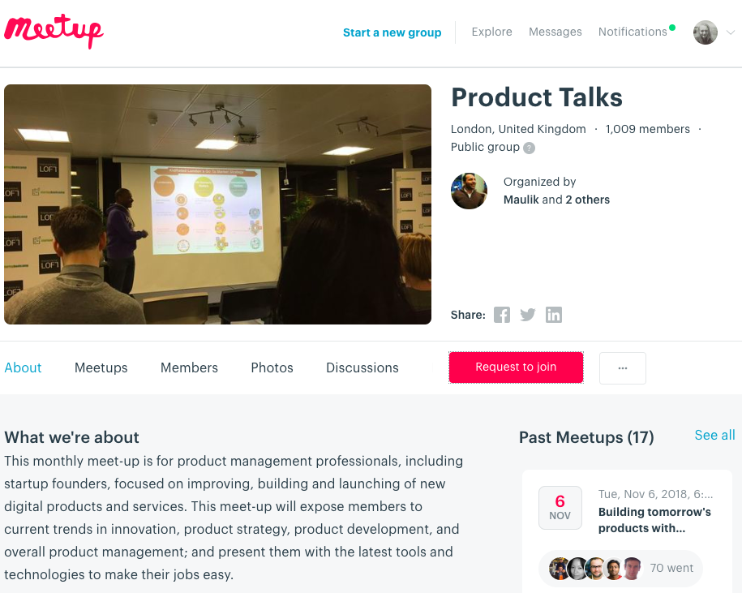

Slide 2
From MVP to Enterprise Applications,
we build award-winning digital products
We bring together an expert team of engineers,
designers, researchers and product strategists to
craft user-centric, innovative products.
In collaboration with our clients, we build engineering
cultures and outperform competition in the process.

Slide 3
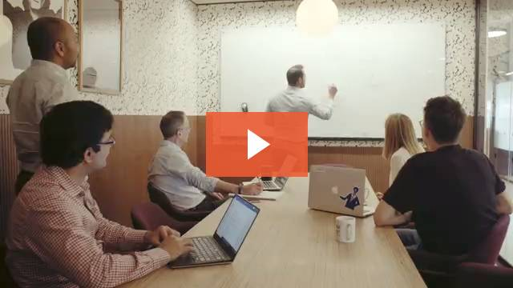
About us
Innovify is a digital product studio for enterprises & start-ups, demanding the very best in new product development and business transformation by harnessing the power of disruptive technologies.
With a lean and agile mindset, we go beyond traditional enterprise application development to provide a full range of digital services to not only build user-centred products, but we also disrupt markets for our clients to grow and transform; an ideal intersection of user, technology and commerce.
With a diverse team of highly competent talent, we have become the trusted partner for our clients to manage the entire product development life-cycle across the full spectrum of internet-enabled smart devices, including web and mobile.

Slide 4
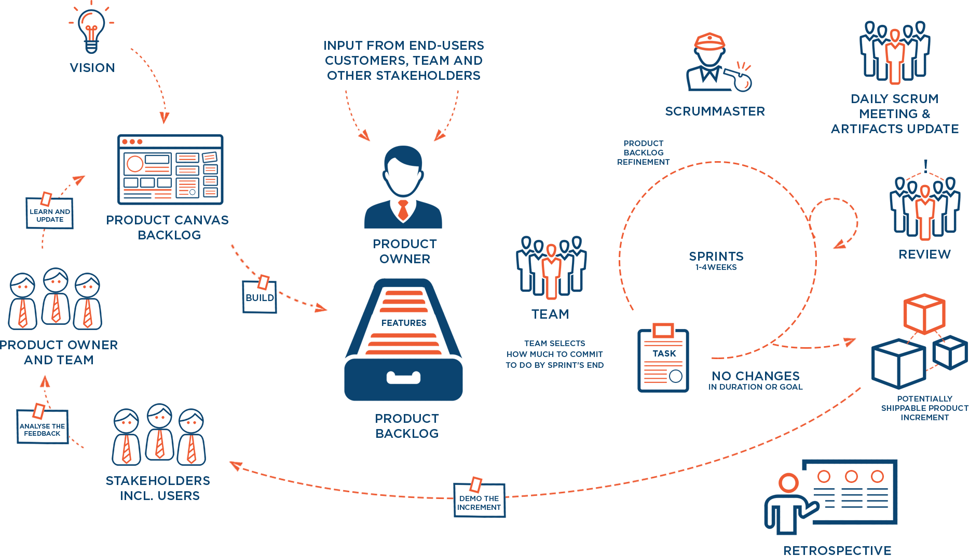
FROM IDEATION TO REALISATION

Slide 5
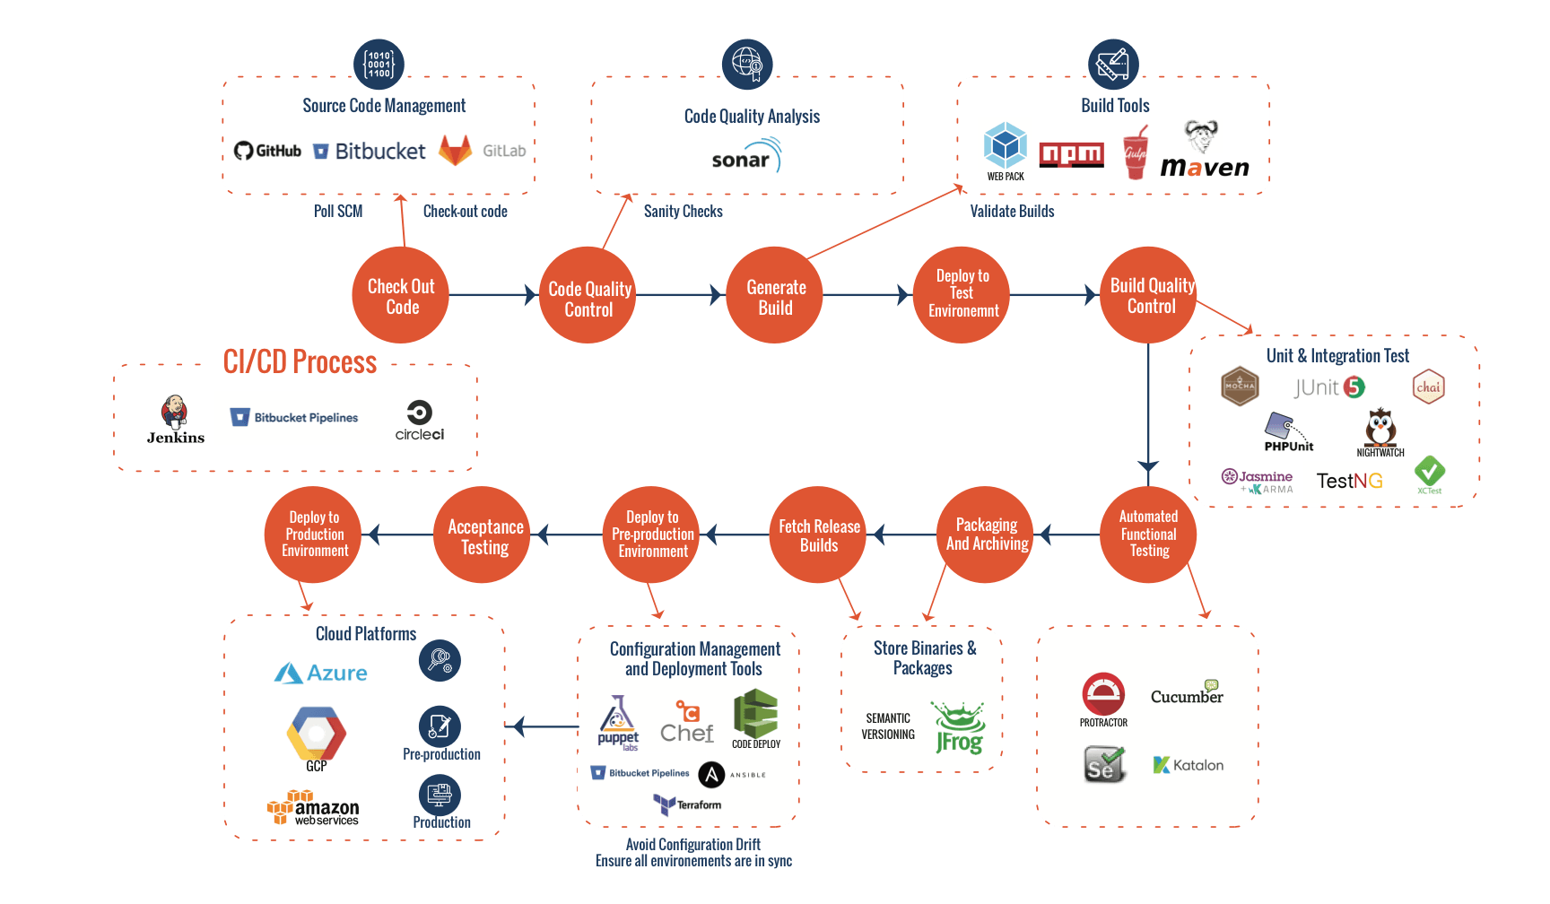
CONTINUOUS DELIVERY
The wrong structures clog up the machine, slowing down development and impeding on the quality of the final product. We ensure it doesn’t happen with a factory-like system of continuous integration and delivery.

Slide 6
Our Services
Innovate
Disrupt
Grow
Transform
Innovation Workshop
User Discovery & Design Sprints
User Experience Design
MVP & Proof of Concepts
Enterprise Application Development
Mobile Application Development
Quality Assurance & Test Automation
Continuous Delivery & DevOps
360* Analytics & Insights
A/B & MVT Testing
Funnel Optimisation
Business Events Reporting
Digital business transformation
Scale agile transformation
Process automation
Lean product management

Slide 7
Our Approach
User Focus
Your user is at the heart of everything that we do. This allows us to deliver the best possible UX across every touchpoint.
Business Value
We bring commercial insights that create value for our clients at every stage of the process.
Technology Excellence
We engineer solutions using state-of-the art technologies, ensuring that the best possible results are achieved.
Collaboration
Unlike others, we partner with you to ensure that we truly understand your vision and strive to surpass your expectations.
Talent
We only hire the best talent and provide a competitive environment, encouraging continuous improvement.
Transparency
Our processes are structured for you to be in control, with all the project information available at your fingertips.

Slide 8
OUR ADVANTAGE
 | Innovify | In-House Teams | Outsourcing (Agencies & Offshoring)
Cost Efficient | Medium | Low | High
Wide & Deep Tech Stack Capabilities | High | Low | Medium
Product Management | High | High | Low
Agile Transformation | High | Medium | Low
On-site Client Collaboration | High | High | Low
Extreme Programming Principles | High | High | Low
Software Quality | High | High | Low
Support Services | High | Low | Low
Expert Talent Network | High | Low | Low

Slide 9
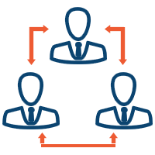
Our industry experience
Financial Services
Entertainment, Media & Publishing
Logistics & Operations
Insurance
Education & Learning
Energy & Utilities
Retail, eCommerce & Marketplaces
Software & Technology
Property & Investments
Government
Travel & Hospitality
Recruitment

Slide 10
Our expertise
FRONT-END DEVELOPMENT
BACK-END DEVELOPMENT
E-COMMERCE & CMS
Angular
React
Node
PHP
Java
Magento
Wordpress
MOBILE
CLOUD
DEVOPS
iOS
Android
React
Native
AWS
GCP
Azure
Circle CI
Jenkins
Terraform

Slide 11
Clients

Slide 12
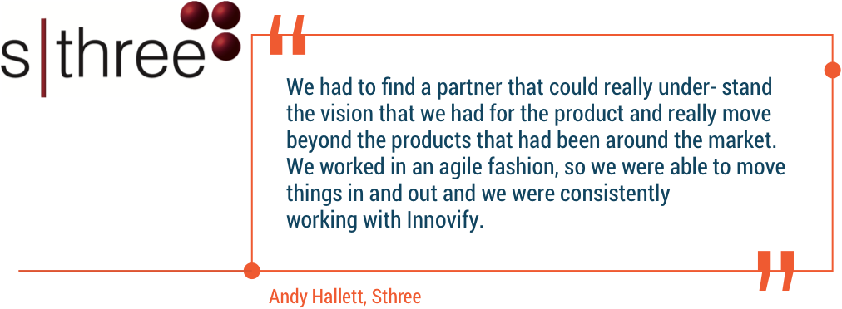
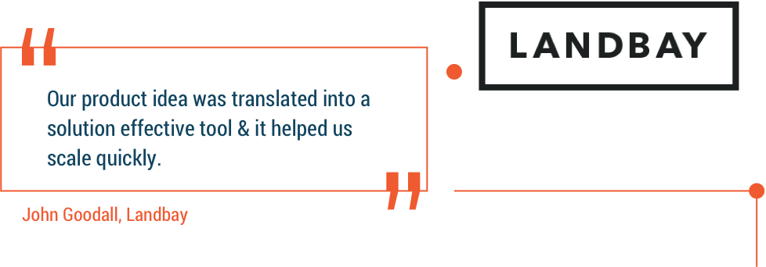
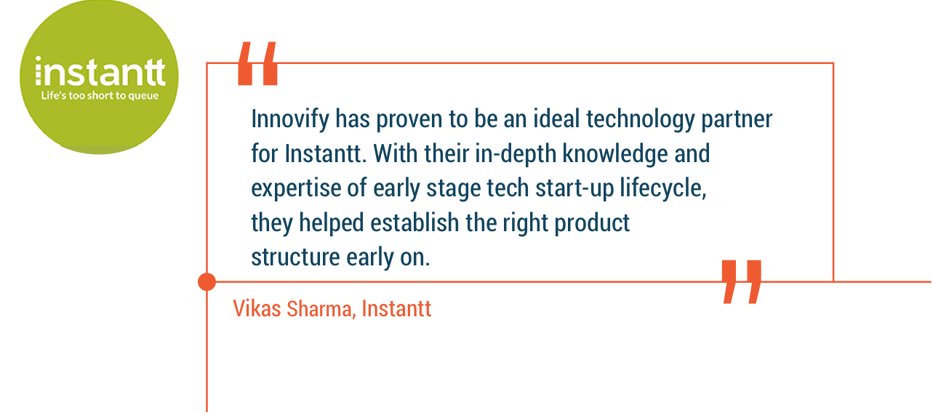
Clients Speak

Slide 13
Ventures

Slide 14
What is Showcaser?
A video platform that puts personality over paper
For any way you communicate
Candidate Feedback
Video Interview
Handling Objections
Video
CV’s
Shortlist Presentation

Slide 15
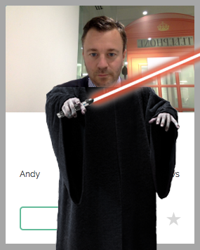
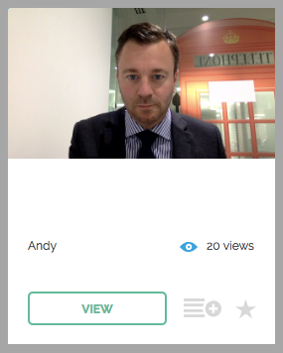
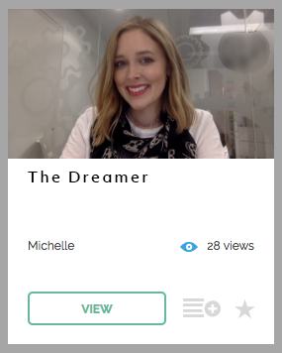
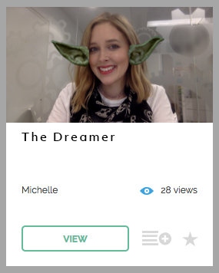
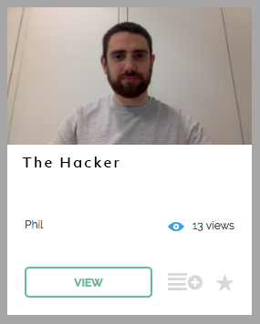
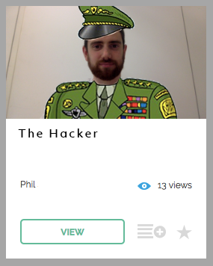
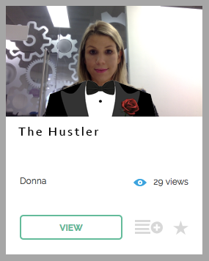
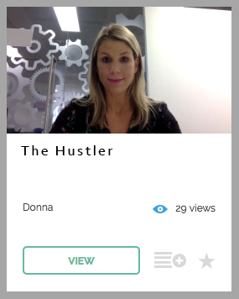
Investing In The Startup Golden Triangle: Dreamer, Hacker and Hustler
Dark Overlord
Investment Director
Product Manager and Co-Founder
Development manager
Head of Sales
“May the force be
with you”
“You can’t handle the
truth!”
“I’m going to make him
an offer he can’t refuse”

Slide 16
The Dreamer
Learn from the past. Organise the present. Dream about the future…

Slide 17
A (not so) long time ago…
A long time ago, in a galaxy not so far away…
The CV reigns supreme in the UK job market.
GDPR is coming into effect. More and more skilled people are being hired from abroad. Endless products and processes are evolving to deploy attacks against the Recruitment Industry as we know it. Merciless legions aim to seize control of the Industry.
Only General Andy Hallett’s band of Resistance Innovators are prepared to face the rising tide of technology set to disrupt the Industry.
But the video prototype, Clickterview has been exposed. It was built in Flash, copying the existing tech on the market. As the prototype speeds towards a crash, the Innovators retreat to decide their next move.

Slide 18
The Importance of Competitor Analysis
The Dark Side:
Imitation is the highest form of flattery, and the lowest form of innovation
It’s not enough just to analyse the competition
Resistance:
You must see what they do, but resist the urge to follow suit
Watch how people interact with the products
Ask yourself what’s missing, not what’s out there

Slide 19
Space Matters
OPPORTUNITY
IS
NOWHERE
NOW
HERE

Slide 20
Opportunity is Everywhere
Nothing happens in a vacuum
Alice goes to America
MyKnowledgeMap
Getting the “W”

Slide 21
“Do or do not there is no try”
Juggle
/ˈdʒʌɡ(ə)l/
Verb
juggling
continuously toss into the air and catch (a number of objects) so as to keep at least one in the air while handling the others.
cope with by adroitly balancing (several activities).

Slide 22
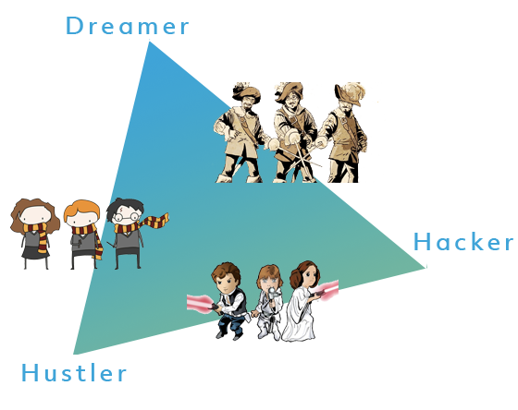
Join Forces

Slide 23
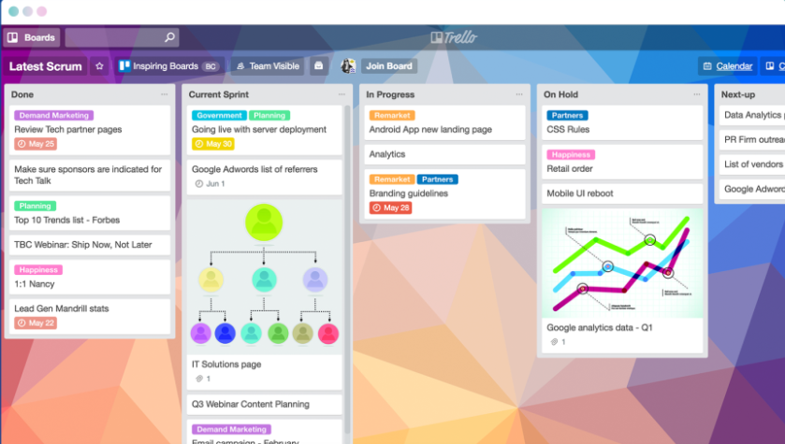
Toolkit
Getting the team speaking the same language, best Project Management tools
Trello
Appear.in
Slack + don’t underestimate the integrations
Parking Lot

Slide 24
The Hacker

Slide 25
Managing expectation
Notes:
Before explain why important -- role

Slide 26
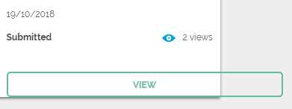
My Role
Backend developer
Frontend developer
Tech lead
System architect
CTO
Development manager
DevOps engineer
3rd Line support
Database analyst
Implement UI
… Badly
Notes:
In no order

Slide 27
Chief team leading technical database support analyst developer architect manager
… Badly
that also implements UI
Notes:
Longest self styled job title
18 chars long --- linkedin
Settled on….

Slide 28
Chief team leading technical database support analyst developer architect manager
… Badly
that also implements UI
“Development Manager”
Notes:
Really means
Responsible for all plan + impl
Privilege work with all
End user --- big boss
Learnt --- Feel underrated importance

Slide 29
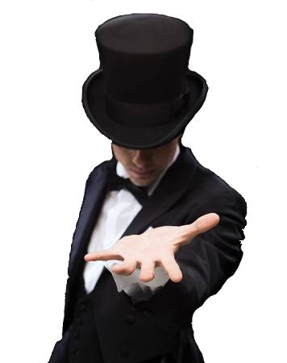
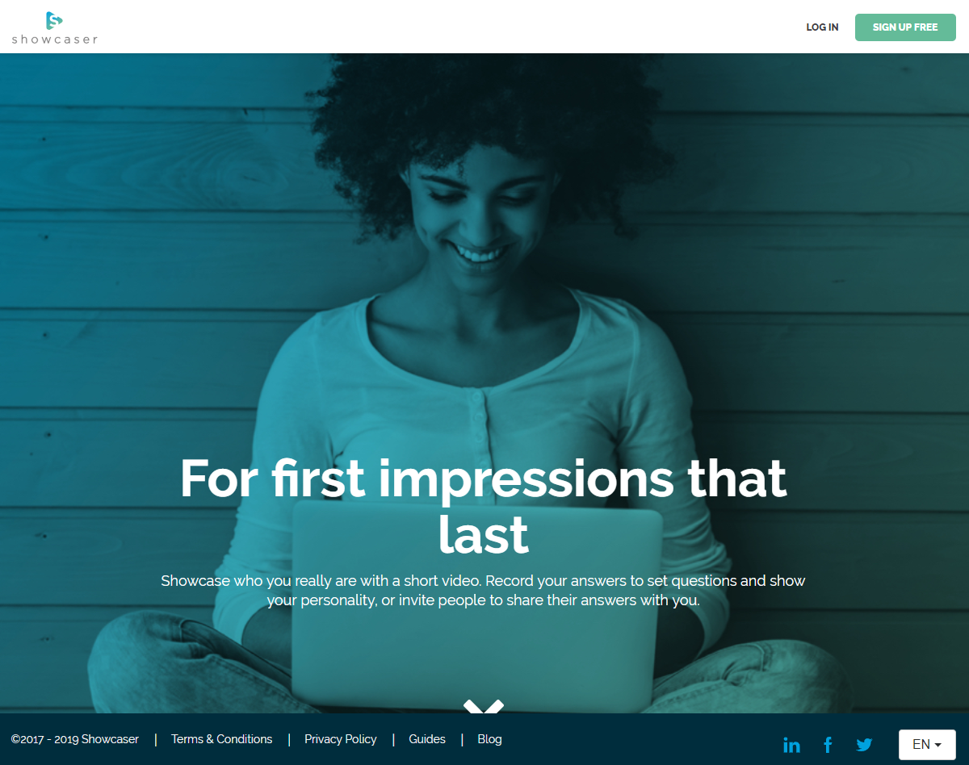
How they see it…
Notes:
How most people see dev process

Slide 30
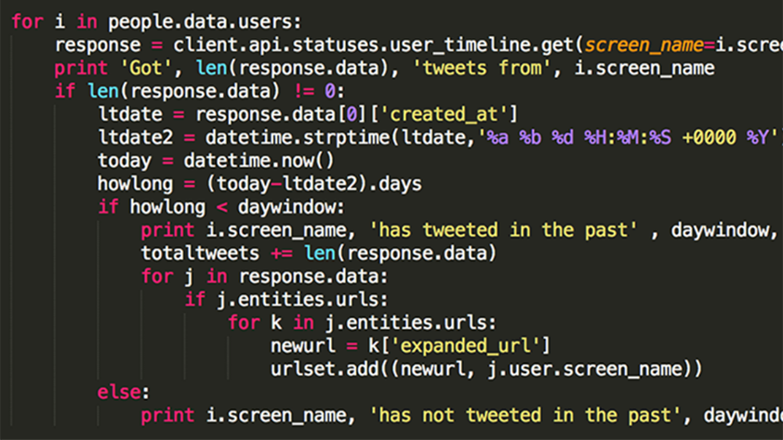
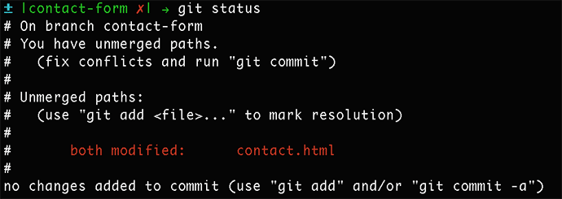
How it really is…
Coffee & procrastination
Load development environment
Reddit....
Lunch!!!
Real work begins
Notes:
Reality is very different
Starts with coffee and general procrastination
While dev env loads
Then time to catch up on Reddit
Before you know it, lunch time. 3h at 11
An hour or so working on the amazing new feature that was promised before Christmas
Further 30m --- indents, remove erro spaces, change var names --- keep code analyser happy
Finally deal with this…. Dreaded merge conflict
Pretty intense
Limited time – delivery as much, economically. Vital, not flashy, basic func impl, reviewed and refined.
Buzzword ‘Agile’

Slide 31
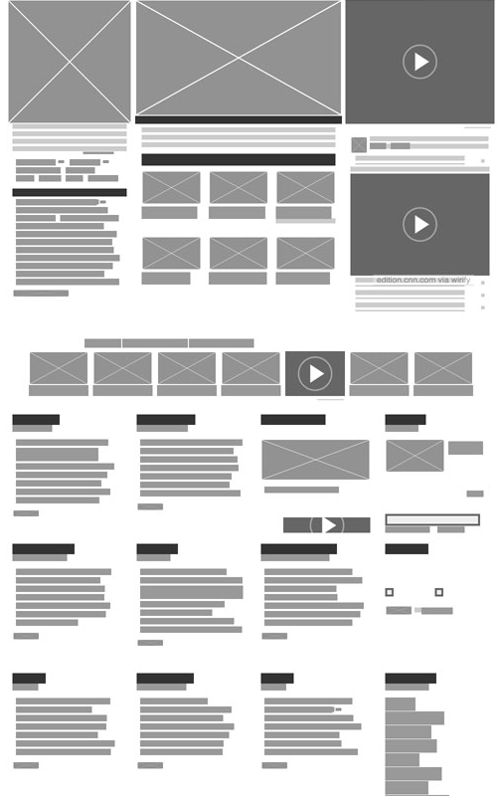
Notes:
As PO – pretty distressing seeing this happen to product
Important as
Chief team leading technical database support analyst developer architect manager that also implements the UI… Badly
Out of backlog has controlled scope and realistic
Tech/platform
Resources/skills
Timeframe

Slide 32
Notes:
As PO – pretty distressing seeing this happen to product
Important as
Chief team leading technical database support analyst developer architect manager that also implements the UI… Badly
Out of backlog has controlled scope and realistic
Tech/platform
Resources/skills
Timeframe

Slide 33
“Keep it real”
Notes:
Most important part of job
To Turn idea into revenue
Not just at beginning --- ongoing negotiation
Reason nego is tendency to dismiss --- sounds impossible or ludicrous
Urge consider craziest --- even integrating with cryptocurrency

Slide 34
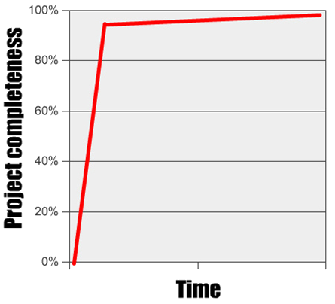
Don’t sweat the small stuff
Notes:
Devs
Stubborn creatures --- stickler for detail
Great but 80/20 rule --- release early and refine as you go.
Final take-away is
Whomever work with --- internally/externally --- vital part of tech role in startup --- understand their expectations and manage effectively.

Slide 35
You can’t do everything
yourself
Notes:
Or can you…?
Stated at beginning --- do bit of dev, database, devops, support
Doing everything --- not great at any one thing
Could do it, would take years

Slide 36
What are my options?
Contractors
More developers!
Notes:
DevOps for a month
UI designer 2 days a week
Double up on mobile devs
Solve first few issues with contractors
Not cheap
If delays, can be expensive endeavour
Personal fav. Is make someone elses problem

Slide 37
Notes:
Do it all day, every day
Adapt size of teams and skills to project needs
Depending on stage or as issues and changes arise
Do it for multiple projects --- know what they’re doing
Tech roadmap, perform validation/testing, and manage delivery of MVP
Important to build partnerships early.

Slide 38
Who has time for
governance?
Notes:
If I presented a year ago, next slide would look something like…

Slide 39
The answer: No one!
Stifles innovation
Unnecessary time wasting
Pointless hurdles and red tape
Corrupted by corporate politics
“Arse covering”
Notes:
Majority of career in startups
Done corporate where takes
23 emails
7 approvals
2 committees to change typo
Put off

Slide 40
Corporate innovation?
Notes:
Showcaser is unique
Enjoy Freedoms to innovate and experiment
Sit under umbrella of corporate with well established governance structure
Has changed mind
Important to get tech decisions right as early as possible
Limited funding --- no time to waste effort correcting mistakes when innovating
Startups often fall into the trap of saying “yeah we can do that!” but never has “Should we?” or “How?”
Very easy to skip over those two questions when you’re so close to the core of the product.

Slide 41
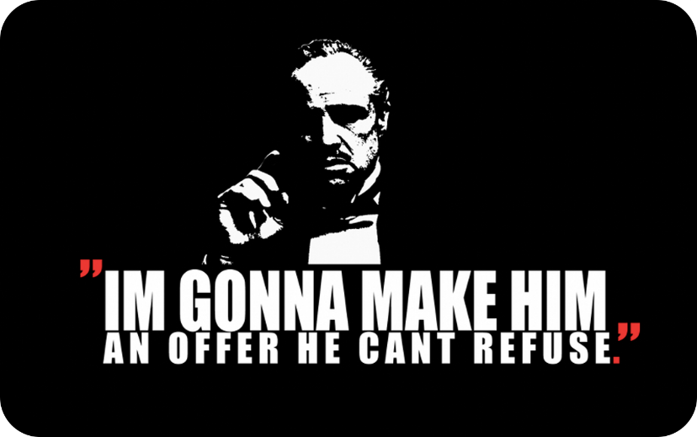
The Hustler
Notes:
Michelle has gone through it’s inception
We’ve now built the product, it’s time to get people using it.

Slide 43
Product Market Fit
Training
Uni Application
Auditions
Adoption
Event Feedback
Internal comms
Oral exams
And many more!
But what was the most popular?

Slide 44
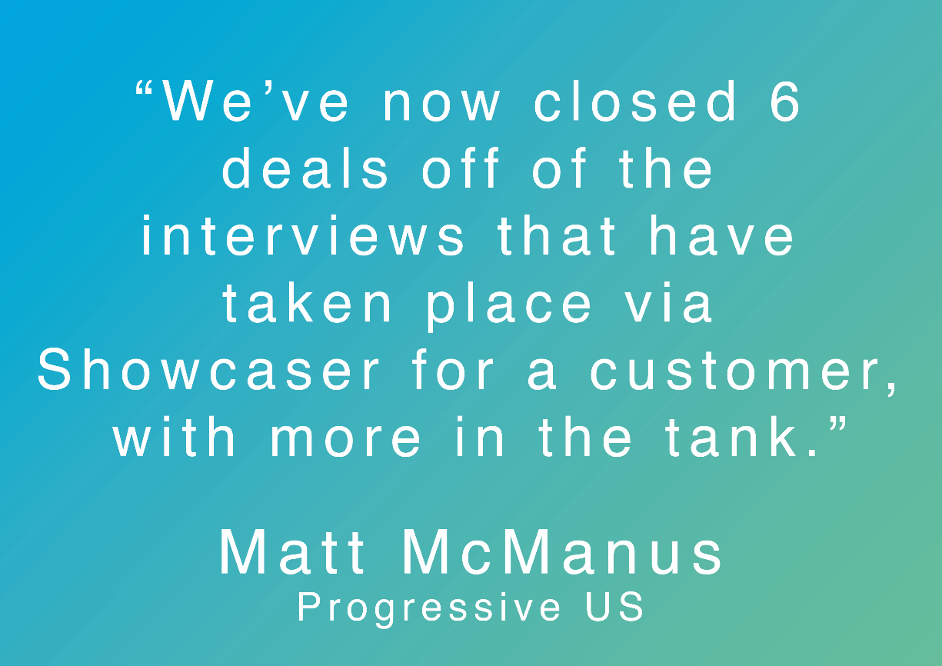
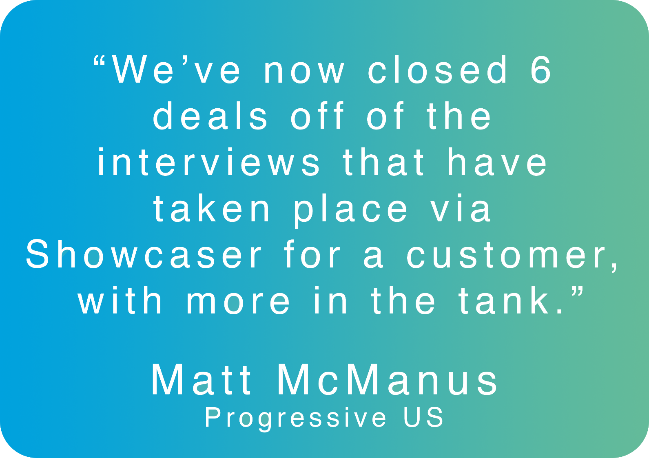
Nail It

Slide 45
Pleasure/Pain Cycle
Got the Meeting
They’ve signed with a competitor
Great Demo
They LOVE it
We’ve got a bug!
SALE
Lost the deal

Slide 46
Love it, and they will love it too.

Slide 47
Knowing When to Let Go
Product huddles
Teamwork / Trust
Agree Boundaries (Marketing, Sales, Account Management, Product Support)
Set clear expectations
Utilise tools such as Slack / Trello
Manage client expectations
If you dropped the ball, why?

Slide 48
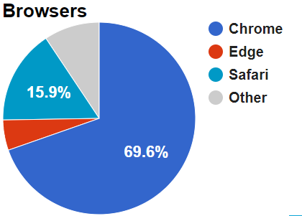
Where are we now…
1164
2986
Happy Customers … 100%

Slide 54
Jr Product Manager
Tech Lead
Freelancers:
UX
PMs
Developers

