Slide 2
The devil is in the details
Akil Benjamin
Head of Research, Comuzi
@akilbenjamin
Notes:
I’m Akil
I’m Grace
This is the first time we’ve done this talk together, so bear with us - and we’ll try to keep each other to lightning time!

Slide 3
WHO ARE COMUZI
We work with innovators to create next generation products and services which are good for both people and business.
@akilbenjamin
Notes:
AKIL

Slide 4
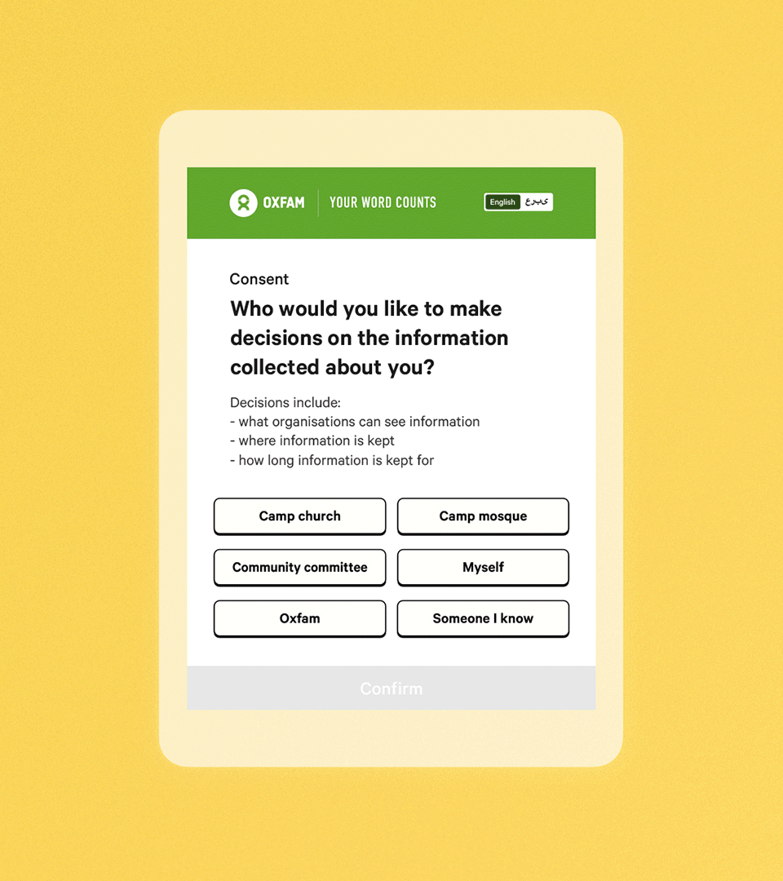
WHO ARE IF
IF is a technology studio, specialising in ethical and practical uses of data and AI
Notes:
GRACE IF is a technology studio, specialising in ethical and practical uses of data and AI

Slide 5
At Comuzi we have one approach
@akilbenjamin
Notes:
We explored automated decisions because they have such an impact on our lives.
Choosing a sensitive topic area (mental health) where, many chatbots already exist, we looked to see if we could improve the way young people navigate these situations.
This was a rapid experiment but it highlights some key interactions and principles we could carry forward to make better products geared at creating positive human interactions.

Slide 6
Building Alphas
@akilbenjamin

Slide 7
Comuzi building alphas
The Launchpad Programme: LIFTOFF
@akilbenjamin

Slide 8
UX<HX
@akilbenjamin

Slide 9
COMUZI and IF worked together to answer the question:
How can we expose the seams of a mental health chatbot to make its actions explainable?
@akilbenjamin
Notes:
We explored automated decisions because they have such an impact on our lives.
Choosing a sensitive topic area (mental health) where, many chatbots already exist, we looked to see if we could improve the way young people navigate these situations.
This was a rapid experiment but it highlights some key interactions and principles we could carry forward to make better products geared at creating positive human interactions.

Slide 10
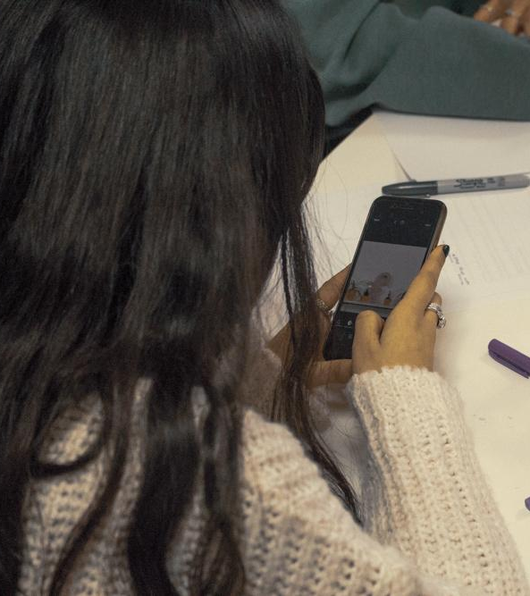
MoodJar Research
@akilbenjamin
Notes:
As we conducted this experiment some of our findings were around:
The relationship we have with the technology, specially automated decisions
Why they choose to use certain technologies over others
How young people think it all works

Slide 11
TOOLS NOT FRIENDS
@akilbenjamin
Notes:
Speaking to their relationship with technology, young people already have strong opinions on how emerging technical systems should work. We learned that was especially true about AI, and the situations automated decisions should be used in.
The young people we spoke to had the following shared opinions:
It should not try to foster a humanlike relationship everything and its limitations should be clear. It is important AI discloses it is artificial or automated in the beginning of the interaction or engagement
The app should forget their entire history of interactions when it is is deleted or removed. Unless specifically directed, AI powered chatbots and tools should not betray privacy

Slide 12
“I know it’s a bot... with a non-biased opinion. I rather it not be personal then I would have to talk to it like a friend, then why wouldn’t I go speak to a friend?”
User research participant
@akilbenjamin
Notes:
Many young people wanted to interact with MoodJar because it was a ‘bot’. They trusted that they would get a response based on what they said and nothing more. This was one of the key reasons why the young people appreciated the interaction with MoodJar, valuing this method of expression over talking to friends in such circumstances.
What they identified as bias, we identify as objectivity.
Young people are actively aware of their decisions to use certain technologies to address their issues and will chose the most accessible solution.

Slide 13
“...I can always go and find out more if I wanted”
User research participant
@akilbenjamin
Notes:
Not all our user research participants actually agreed with this quote.
They were divided. The two group our research participants identified under were:
An individual who expects information security from the digital products and services they use. They don’t really need to truly know how a technical system works, just that it does.
An individual who expects both privacy and information security from the digital products and services they use. These people look to dig a little deeper, beyond the surface, to understand if their expectations are being met.
Both IF and Comuzi believe we should be designing for the second persona at all times as it gives people more agency to choose how their information is used and a deeper understanding of what’s going on in an accessible way.

Slide 14
Concepting MoodJar
@akilbenjamin

Slide 15
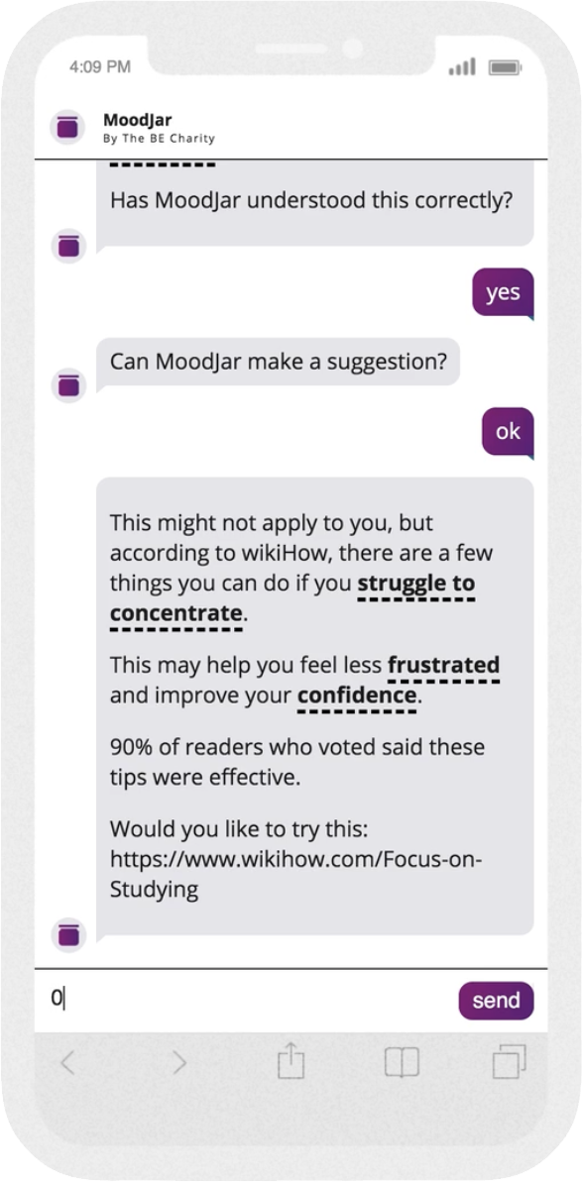
Designing MoodJar
@akilbenjamin
Notes:
We did some user research sessions with young people to find out what a positive human interaction with automated decisions was to them.
We found 23 insights and 6 key themes. Using these insights we designed MoodJar, a mental health chatbot which uses automated decisions to assist with an individuals mental health and looked to see if making our system more explainable was of benefit in helping them navigate app.
Informed not told: Language was a big thing for young people. They wanted to feel like they had agency over their conversations, especially as they’re in a position when they’re told to do a lot of things.

Slide 16
Designing MoodJar
Young people wanted to be informed not told by automated decisions
@akilbenjamin
Notes:
We did some user research sessions with young people to find out what a positive human interaction with automated decisions was to them.
We found 23 insights and 6 key themes. Using these insights we designed MoodJar, a mental health chatbot which uses automated decisions to assist with an individuals mental health and looked to see if making our system more explainable was of benefit in helping them navigate app.
Informed not told: Language was a big thing for young people. They wanted to feel like they had agency over their conversations, especially as they’re in a position when they’re told to do a lot of things.

Slide 17
Designing MoodJar
Young people wanted to be informed not told by automated decisions
The collection of information should be transparent
@akilbenjamin
Notes:
Young people are aware of the digital environment they enter when using apps and understand that in many cases the exchange of it being free is to if the brand or company can use their data.
In this context they did not want their data being exploited or used for alternative purposes.

Slide 18
Designing MoodJar
Young people wanted to be informed not told by automated decisions
The collection of information should be transparent
Knowing the outcome of profiling can be unhelpful
@akilbenjamin
Notes:
Lastly in line with the setting of a mental health chatbot young people wanted support not to be diagnosed. They understood they could go seek professional help to be diagnosed. A the current time of interaction they just need help.
These insights directed the design of MoodJar from the name to tone of voice, to how we designed the UI interactions because as Grace said the devil is in the detail.

Slide 19
Prototyping MoodJar
@akilbenjamin

Slide 20
“
It’s clearly scanning for key words to understand my mood. It has understood my mood correctly so I’m going to say yes!
”
@akilbenjamin
Notes:
To answer the question given to us in the brief. I think the answer is yes.
You can show the inner workings of a chatbot to make automated decisions more explainable.
But now we know the answer is yes, and we know that we can do it and create positive human interactions.
The question is… where else can we do this to improve both understanding and experience of technical systems in society?

Slide 21
“
It’s clearly scanning for key words to understand my mood. It has understood my mood correctly so I’m going to say yes!
”
@akilbenjamin

Slide 22
You build better products when you design for agency, and show care
@akilbenjamin
Notes:
The future is *not* a connected fridge.
The real opportunity of emerging tech is solving actual problems - and making people’s lives better
Technology shapes, and is shaped by, the societies that create and use it. It’s up to us what that looks like in the future.

