Slide 3
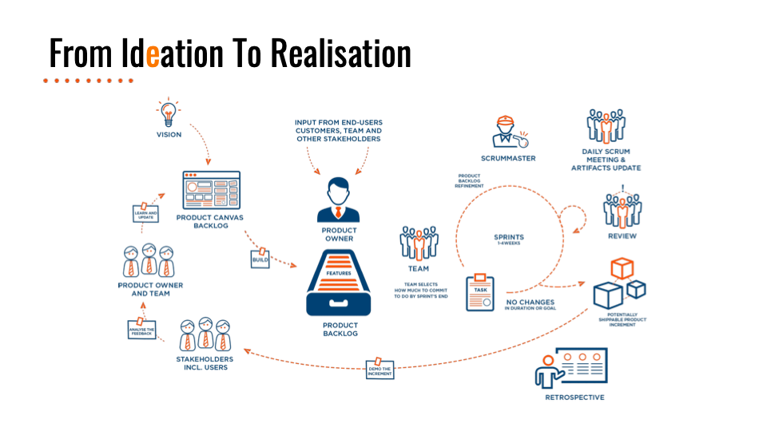

Slide 7
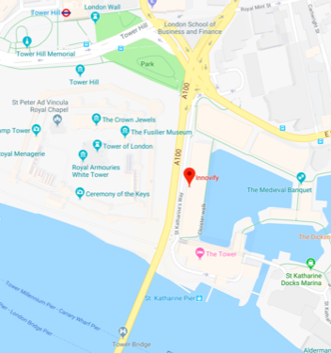
Get In Touch

Slide 8
Strategic Thinking
for Product Managers
Mattijas Larsson
@MattijasLarsson
Notes:
Introduction

Slide 9
Disconnected

Slide 10
Connect
Notes:
The need for Strategic Thinking
Product Strategy
Strategic Planning
Strategic Thinking

Slide 11
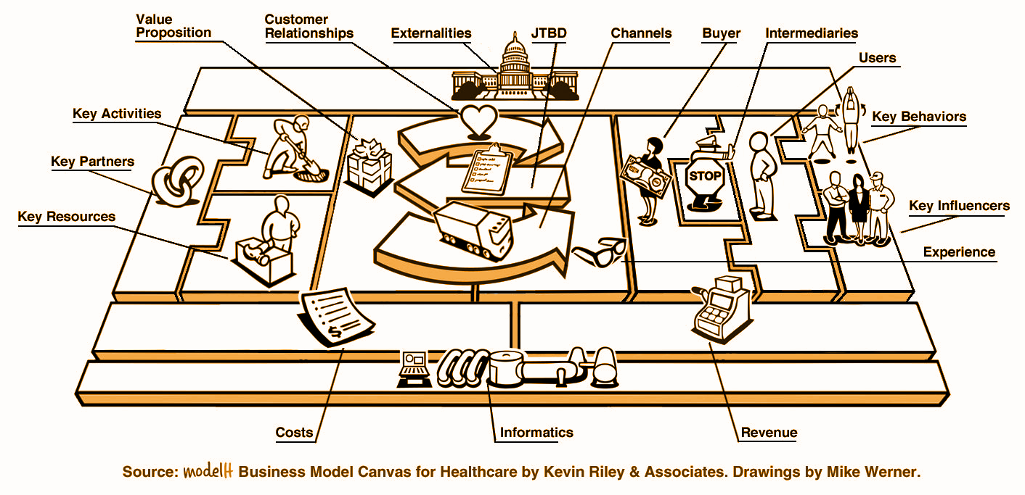
Template Solutions

Slide 12
Thinking in Time

Slide 13
Diagnose

Slide 14
Define Policy

Slide 15
Take Action

Slide 16
Scientific Method

Slide 17
Navigate

Slide 18
Thank You!
Mattijas Larsson
@MattijasLarsson

