Slide 1
The Art of Powerful Questions
Peter Bricknell . 27 March 2018
Notes:
https://cdns3.trainingindustry.com/media/2041014/spg%20the%20art%20and%20science%20of%20asking%20effective%20questions.pdf

Slide 2
Breaking Bad (Questions)
6 Step Structured Interview
Overcoming Resistance
The Columbo Question
Bad Questions
The Art of Thinking in New Ways
Notes:
Night and Day – MC Escher

Slide 3
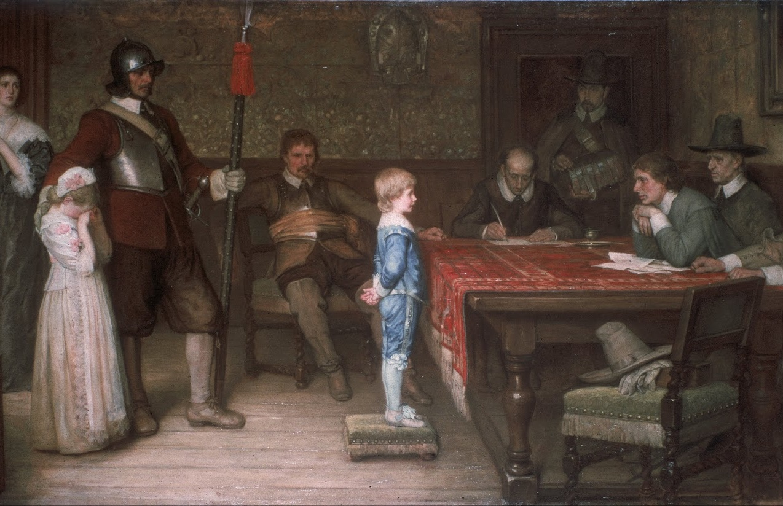
Bad Questions
Can be threatening
Close down vs Open Up
Leading vs Learning
Notes:
When did you last see your father? - William Frederick Yeames RA (18 December 1835 – 3 May 1918)
(Patterson, et al., 2011)
Leading Questions. You assume the answer, so you lead them to agree with you. (And most people try to please, or follow the path of least resistance) "How late do you think that the project will deliver?". This assumes that the project will certainly not be completed on time
Guessing (or mind reading) This is where you assume you know what the other person means, or that they need to read your mind. Often the other person's definition does not match yours. "What kind of CMS do you need?” (assumes they need a CRM, and they know what one is (CMS = content management system, or carrier management system, depending on context).
The Presumptive Yes - a question that assumes one answer, and makes it hard to say the opposite without an argument "You do think I'm right about this product, don't you?". "Shall we all approve Option 2?" is more likely to get a positive response than "Do you want to approve option 2 or not?".
The Non-question - a statement that is really a criticism "Why didn't you put out the trash again?"
The Aggressive Why - the word 'why' is rarely used to understand, but mostly used to get the other person to explain their 'stupid' actions "Why didn't you call them before?"

Slide 4
Bad Questions
The Presumptive Yes
Leading Questions
The Non Question
Guessing
The Aggressive Why
Notes:
When did you last see your father? - William Frederick Yeames RA (18 December 1835 – 3 May 1918)
(Patterson, et al., 2011)
Leading Questions. You assume the answer, so you lead them to agree with you. (And most people try to please, or follow the path of least resistance) "How late do you think that the project will deliver?". This assumes that the project will certainly not be completed on time
Guessing (or mind reading) This is where you assume you know what the other person means, or that they need to read your mind. Often the other person's definition does not match yours. "What kind of CMS do you need?” (assumes they need a CRM, and they know what one is (CMS = content management system, or carrier management system, depending on context).
The Presumptive Yes - a question that assumes one answer, and makes it hard to say the opposite without an argument "You do think I'm right about this product, don't you?". "Shall we all approve Option 2?" is more likely to get a positive response than "Do you want to approve option 2 or not?".
The Non-question - a statement that is really a criticism "Why didn't you put out the trash again?"
The Aggressive Why - the word 'why' is rarely used to understand, but mostly used to get the other person to explain their 'stupid' actions "Why didn't you call them before?"

Slide 5
Breaking Bad Questions
Mutual Respect
Mutual Purpose
Ask Permission
Softening statement
Clean & Open
How not Why
Powerful Pause
… For you”
Notes:
The School in Athens – Raphael
Softening Statement – let’s the brain prepared for the question. Gives a pointer to what the question will be and no surprises.
Tips for Effective questioning
(Khasla, 2008) (Miller, 2004)
Questions help understanding and demonstrate listening
Mutual Respect. So this is about building rapport which includes:
Asking permission to ask a question
Clean and Open questions. Clean questions are ones that allow the other person to open up without assuming or accidentally influence time. For example "When did you break the system?" is not clean. It assumes you broken something. "What happened before the system broke?" is non-judgement and allows a fuller answer. Open questions are ones that don't demand Yes/No or a specific fact. There are times for these - for example, to get data, but usually they don't open conversation.
the Powerful Pause. Real answers take time to think about, so just not saying something encourages the other to fill the silence. Hanging questions with pause can also draw this out - "Tell me more ...." or "Then What Happened"
Mutual Purpose.
Softening Statement. Before asking a question, it's always worth giving context, explaining purpose, or just signposting the question so the subconscious can prepare to find the answers. If the interviewee understands the reason for the question, then they may be more willing to open up.
How not Why. You may have heard of the 'Five Whys' to drill down on core issues. This has a purpose, but the word 'Why' can make the person feel accused. It takes us back to childhood questioning 'why did you do that...'. Alternatively 'How did this happen' can achieve this same purpose, or 'For what reason did ....'.
"...for you?". This is another softening tag, and allows the interviewee comfort that there isn't a 'right answer' to the question. It also makes it personal, rather than an intellectual/theoretical answer. "What does CMS mean, for you?", or "What's important about the application, for you?".

Slide 6
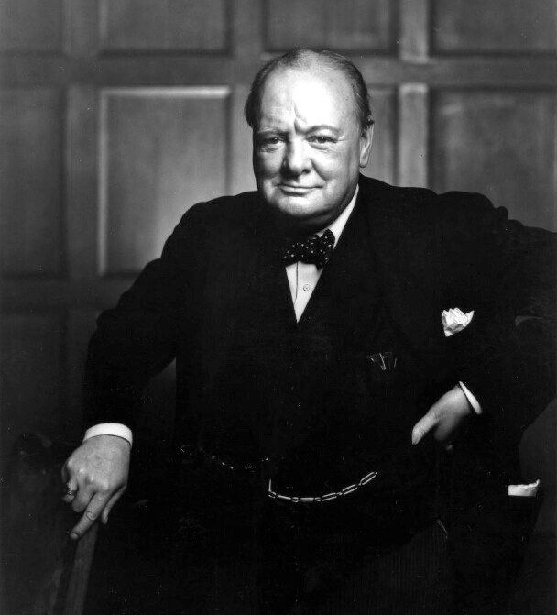
“Out of intense complexities intense simplicities emerge.”
Winston Churchill

Slide 7
From Mahan Khalsa: ‘Let’s get real or let’s not Play’
6 Step Structured Interview
6-S

Slide 8
1. Get a quick list of the underlying issues
6-Step Process for Structuring a Conversation

Slide 9
2 Make sure the list is complete
Is there anything else?

Slide 10
3 Find out which issue is most important
6-Step Process for Structuring a Conversation

Slide 11
4 Go into depth
Evidence
Impact

Slide 12
5 Summarize:
Did I get it right?
Did I leave anything out?

Slide 13
6 Prioritize:
Take each issue in order of priority.

Slide 14
Summary
1
Get a quick list
Anything Else?
Which is most important?
Go into depth
Summarize
Priority order
2
3
4
5
6
https://alsothus.com/powerful-questions

Slide 15
Overcoming Resistance
Repeat the question
Ask again later
Rephrase the question
Change the tone
Name the game
Ask about underlying issues
(Minds, 2016)
Notes:
Repeat the question
The simplest method to use is simply to ask the question again. Many people, when faced with this repetition will see that you are not going to give up and will therefore answer the question properly.
This can turn into a competition where the questioner keeps repeating the question and the other person keeps avoiding. If the avoider is determined, then they can easily win, making this a possibly unsuccessful strategy.
Sorry, you have not answered the question. How much money are you prepared to invest in this?
Ask again later
Sometimes people are not ready to answer the question at the time, perhaps because they have other things on their mind. They may also refuse to answer because of contextual factors such as other people being there and the social embarrassment or status issues that answering would cause.
... (later) How much money are you prepared to invest in the business?
Rephrase the question
Sometimes the question is not understood or the words offend. In such cases, a simple approach is to ask the question using different words. Further explanation and detail around the subject may help clarify the question.
There is an opportunity to help grow the business and get great returns by investing in it. Are you interested in this?
Change the tone
It can also help to reflect on how the question is being asked, for example with a commanding tone that causes reaction or in a weak way that offers refusal as a real option.
Would you care to join us in a new investment? To do this we would need to know how much you would be interested in investing.
Name the game
People such as politicians often play games around questioning, refusing or answering differently. A simple approach to game-players is to names the game, showing them that you can see what they are doing.
Why are you avoiding the question? Do you want to have a share in the company? This will need investment on your part, you know.
Ask about underlying issues
A softer approach is to assume that the person is unable to answer the question for some deeper reason. By taking a counselling or therapeutic position, you can empathize with their problem and try to find out more about why they are feel unable to answer the question.
Is there anything stopping you from breaking the habit at the moment?

Slide 16
The Columbo Question
Is there anything else?

Slide 17
https://alsothus.com/powerful-questions
Have a go yourself
Find 3 people who have a mutual interest that you have
Notes:
Jan Miense Molenaer (1662) – Vrolijk gezelschap (Merry Company)
I like cricket, do you?
Where do you like to go on holiday?
I’m trying to find out people with mutual interests? I wonder – looking at me what do you think we might have in common?

Slide 18
Summary
Clean & Open
Mutual Purpose
Ask How not Why
“For you”
Ask permission
Mutual Respect
Powerful Pause
Soften the question
The Non Question
The Aggressive Why
The Bombshell Tag Words
Presumptive Yes
Mind reading
1
Get a quick list
Anything Else?
Which is most important?
Go into depth
Summarize
Priority order
2
3
4
5
6
Is there Anything Else?
Shttps://alsothus.com/powerful-questions

